Slide 1

Lab 11
FIT5202 Big Data Processing
Data Streaming using Apache Kafka and Spark
Spark Structured Streaming

Slide 2
Lab 10 Agenda
•
Lab 09 Review
•
Apache Kafka
•
Other Topics on Structured Streaming
•
Kafka Producer and Kafka Consumer
•
Output Modes
•
Spark Structured Streaming
•
Output Sink
•
Introduction
•
Triggers
•
Typical Use Case with Kafka
•
DEMO :
•
Click Stream Analysis (Producer and
Consumer)
•
Use case : Log Analysis

Slide 3


Slide 4


Slide 5


Slide 6
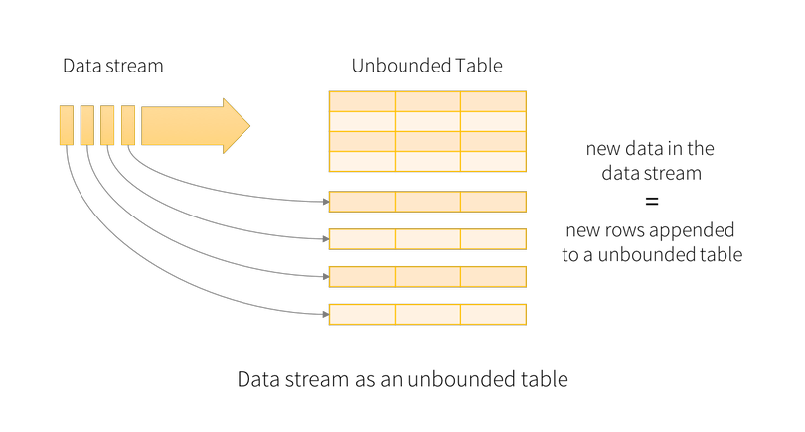
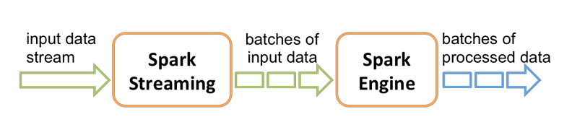
Spark Streaming
Spark Streaming : used the
Structured Streaming : no concept of batch, data is received
concept of micro batches,
in a trigger, appended continuously to the unbounded result
incoming record was a dstream,
table.
and RDD based API
Dstream - provide us data divided into
chunks as RDDs
Resource : Comparison between Spark Streaming and Structured Streaming
Treat a live data stream as a table that is being
continuously appended.

Slide 7
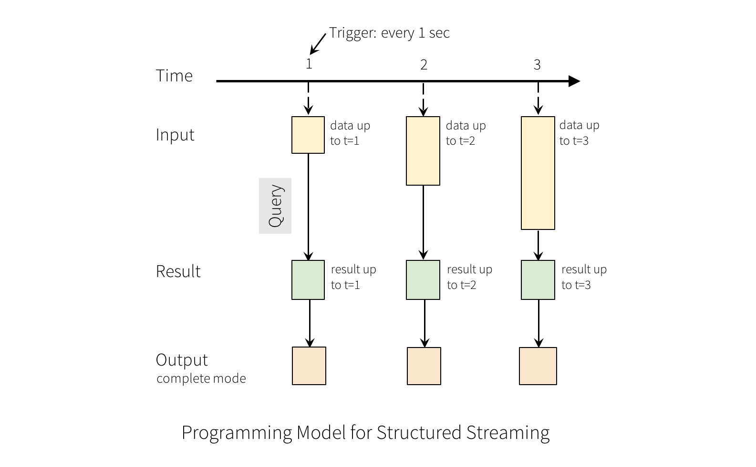
Spark Structured Streaming
•
A query on the input generates the “Result table”
•
At every trigger interval (say, every 1 second), new
rows are appended to the input table, which
eventually updates the result table
•
Whenever the result table is updated, the changed
result rows are written to an external sink.
•
The output is what is written to external storage, it
has 3 modes
1.
Complete Mode
2.
Append Mode
3.
Update Mode

Slide 8

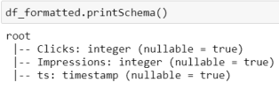

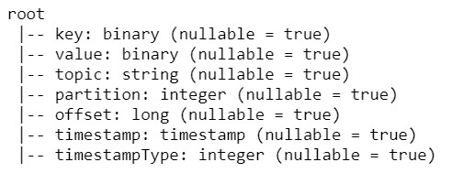
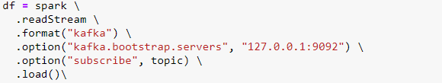
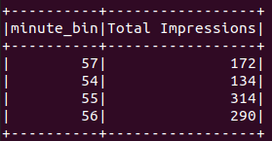


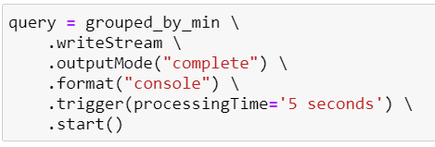
Clickstream analysis
Using the schema,
we convert the
data to a Spark
DataFrame
Cast to String
Parse the string data in json
Kafka producer
format according to the schema
{
"Clicks":"0",
Clicks
Impressions
ts
"Impressions":"6",
"ts":1602944650
0
6
1602944650
}
0
10
1602944650
Kafka format data
0
5
1602944650
- Data in value are byte array
Output result table
Query on Streaming Dataframes
Spark subscribe to topic & read data
For aggregation query,
use ‘complete’ mode

Slide 9
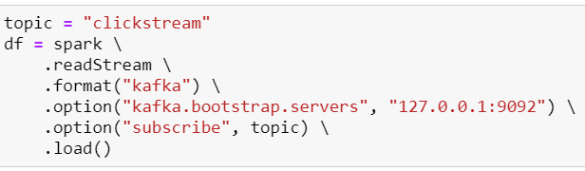
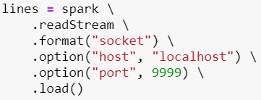
Creating streaming DataFrames
Input Sources
•File source - Reads files written in a directory as a stream of data. Files will
be processed in the order of file modification time. If latestFirst is set, order
will be reversed. Supported file formats are text, CSV, JSON, ORC, Parquet.
Kafka source - Reads data from Kafka. It’s compatible with Kafka broker
versions 0.10.0 or higher. See the Kafka Integration Guide for more details.
Socket source (for testing) - Reads UTF-8 text data from a socket
connection. The listening server socket is at the driver.
https://spark.apache.org/docs/latest/structured-streaming-programming-guide.html#starting-streaming-queries

Slide 10
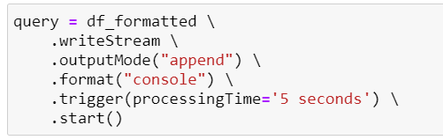
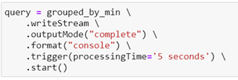
Output Modes
❑ The output mode specifies the way the data in result table is written to output sink
•Append mode (default) - Only the new rows added to the Result Table since the
Just write new rows in
last trigger will be outputted to the sink. This is supported for only those queries
result table to sink
where rows added to the Result Table is never going to change. Hence, this mode
guarantees that each row will be output only once (assuming fault-tolerant sink). For
example, queries with only
select
,
where
,
map
,
flatMap
,
filter
,
join
, etc. will support
Append mode.
Write all the rows to sink
•Complete mode - The whole Result Table will be outputted to the sink after every
trigger. This is supported for aggregation queries (e.g., groupBy).
•Update mode - Only the rows in the Result Table that were updated since the last
Write ‘only’ all the rows
trigger will be outputted to the sink. When there are no aggregations it works exactly
that are updated to sink
the same as “append” mode
https://spark.apache.org/docs/latest/structured-streaming-programming-guide.html#starting-streaming-queries

Slide 11
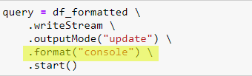
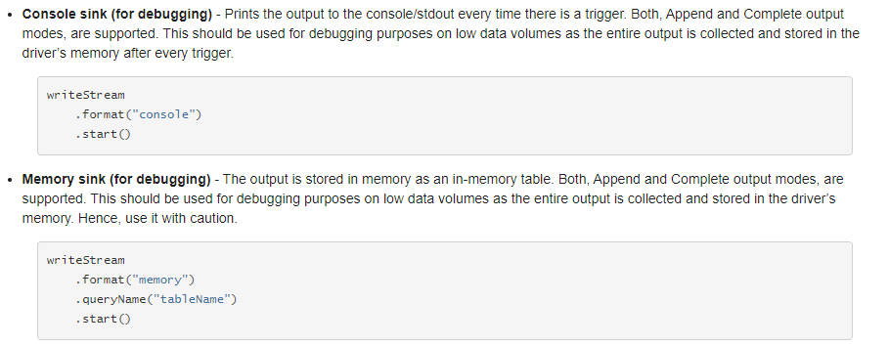
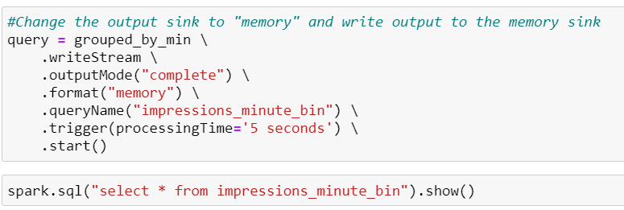
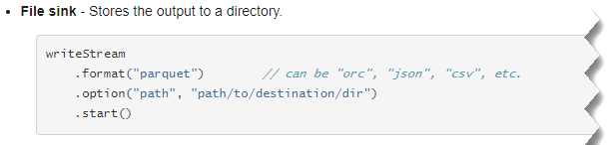
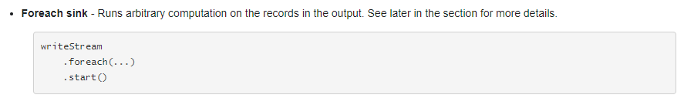
Output Sink
What is Parquet file format [Ref Link]?
Efficient as well as performant flat columnar storage
format compared to row-based csv or tsv files
To view console output: docker logs --follow [container ID]

Slide 12
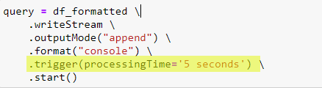
Triggers
— How Frequently to Check Sources For New Data
🡪 defines how often a streaming query should be executed (triggered) and emit the output
1.
Once : only processes once and terminates
the stream
2.
Processing time : Most widely used and
recommended
❑ Processes datastreams as a series of
small batch jobs
❑ gives better control over how often micro
batch jobs should get triggered (e.g.
every 5 secs).
3.
Continuous : Experimental Feature, allows
to process records in milliseconds latency
https://dzone.com/articles/spark-trigger-options

Slide 13
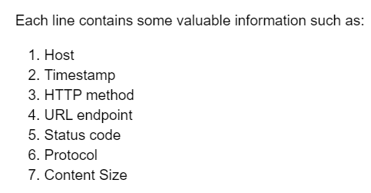
Lab Task: Tracking Server Access Log
❑ Server is going to continuously send a records of a host who is trying to access some
endpoint (url) from the web server
❑ Goal: Perform real time queries from this data stream and output the results.
logs/access_log.txt
Data preparation
Processing (Filter,
aggregation)
Kafka Producer
access_log
Spark Streaming
Output sink (memory,
output to notebook)
Task 2: filters those requests that were not successful (status != 200)
Task 3: Count the number of requests by access status code
Task 4: Output the unsucessful requests (unsucess_df) to memory sink

Slide 14
Handling Array Json
1. Clickstream Spark Streaming - Handling Json Array DEMO

Slide 15
References
Structured Streaming Programming Guide - Spark Documentation
Structured Streaming tutorial - Azure Databricks | Microsoft Learn

Slide 16
Thank You!
See you next week.

